Slide 1
5.3: Graphs of Other Trigonometric Functions
MATH 1550 - Precalculus

Slide 2
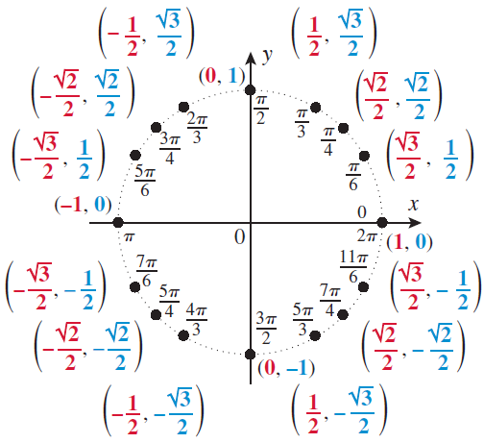
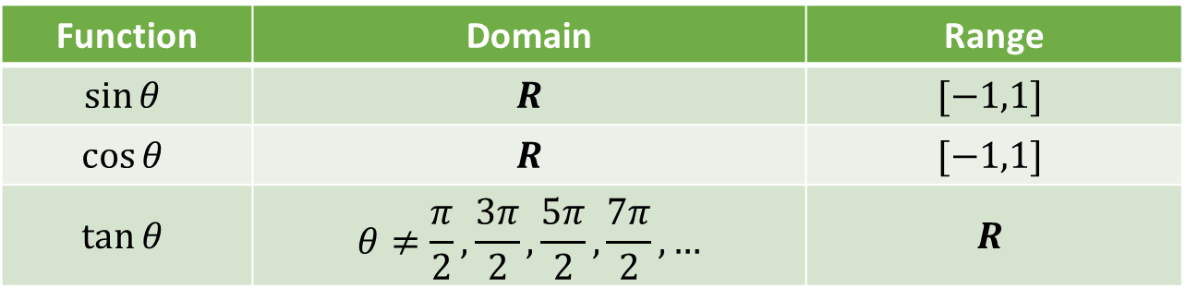
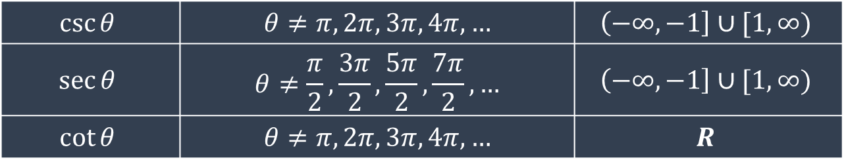
Function | Domain | Range
$$sin⁡θ$$ | $$R$$ | $$[−1,1]$$
$$cos⁡θ$$ | $$R$$ | $$[−1,1]$$
$$tan⁡θ$$ | $$θ≠\frac{π}{2},\frac{3π}{2},\frac{5π}{2},\frac{7π}{2},…$$ | $$R$$
$$csc⁡θ$$ | $$θ≠π,2π,3π,4π,…$$ | $$\left(−∞,−1\right]∪[1,∞)$$
$$sec⁡θ$$ | $$θ≠\frac{π}{2},\frac{3π}{2},\frac{5π}{2},\frac{7π}{2},…$$ | $$\left(−∞,−1\right]∪[1,∞)$$
$$cot⁡θ$$ | $$θ≠π,2π,3π,4π,…$$ | $$R$$

Slide 3
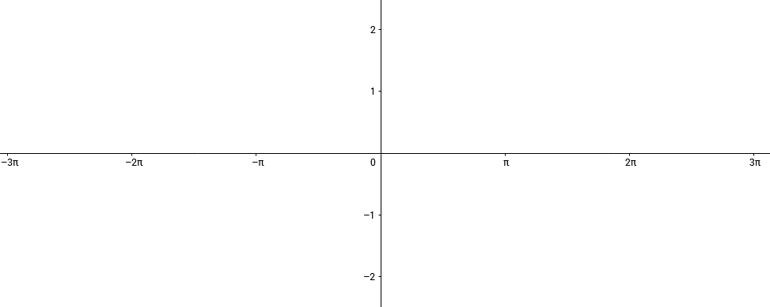

Graph of Tangent, $y = tan⁡(x)$
Notice that the graph repeats every π units.

Slide 4
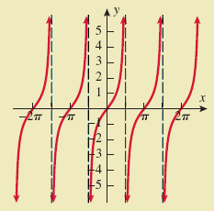
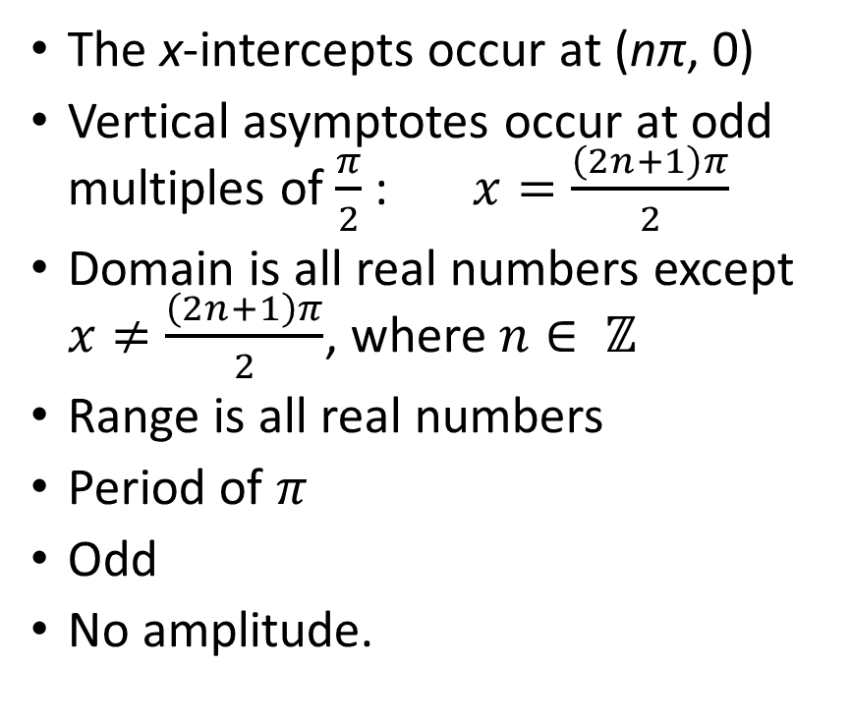

The tangent function, $f(x) = tan⁡(x)$
The x-intercepts occur at (nπ, 0)
Vertical asymptotes occur at odd multiples of $\frac{π}{2}$ : $x=\frac{\left(2n+1\right)π}{2}$
Domain is all real numbers except $x≠\frac{\left(2n+1\right)π}{2}$, where $n∈ ℤ$
Range is all real numbers
Period of $π$
Odd
No amplitude.

Slide 5

Graph of Cotangent, $y = cot⁡(x)$
Notice that the graph repeats every π units.

Slide 6
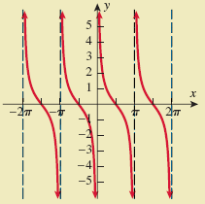
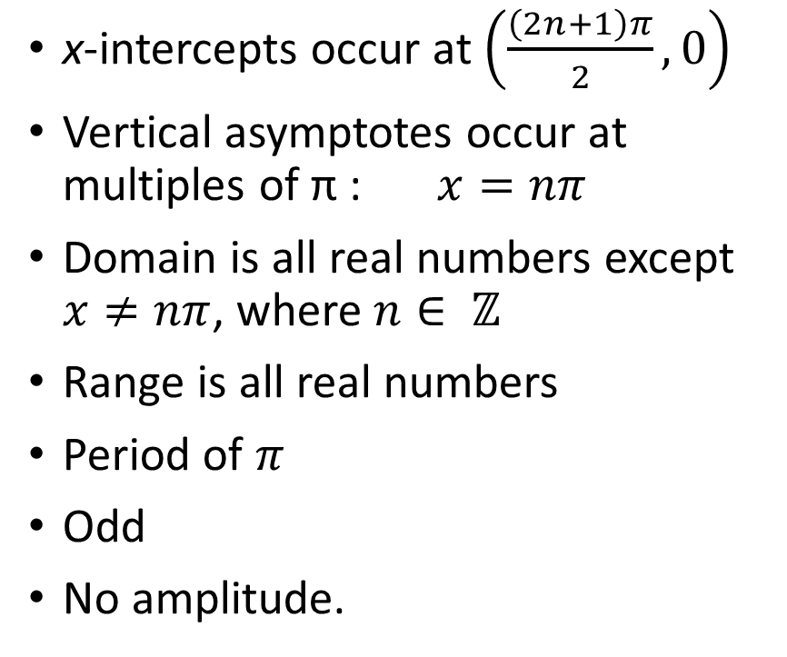

The cotangent function, $f(x) = cot⁡(x)$
x-intercepts occur at $\left(\frac{\left(2n+1\right)π}{2},0\right)$
Vertical asymptotes occur at multiples of π : $x=nπ$
Domain is all real numbers except $x≠nπ$, where $n∈ ℤ$
Range is all real numbers
Period of $π$
Odd
No amplitude.

Slide 7

Graph of Secant, $y=\sec{(x)}$
Notice that the graph repeats every 2π units.

Slide 8
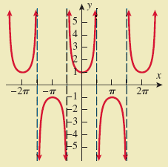
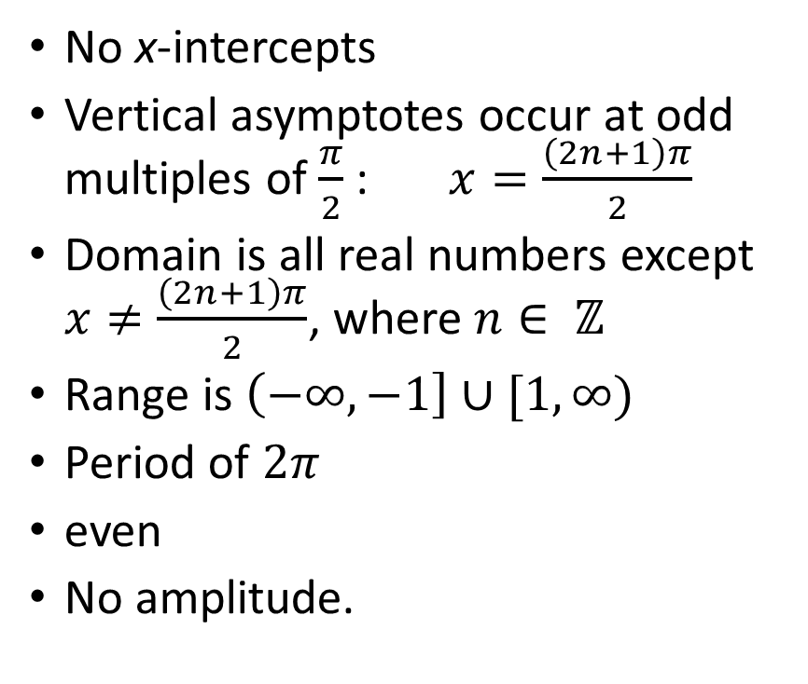

The secant function, $f(x) = sec⁡(x)$
No x-intercepts
Vertical asymptotes occur at odd multiples of $\frac{π}{2}$ : $x=\frac{\left(2n+1\right)π}{2}$
Domain is all real numbers except $x≠\frac{\left(2n+1\right)π}{2}$, where $n∈ ℤ$
Range is $\left(−∞,−1\right]∪[1,∞)$
Period of $2π$
even
No amplitude.

Slide 9
Relationship between Cosine and Secant

Slide 10
Graph of Cosecant
Notice that the graph repeats every 2π units.

Slide 11
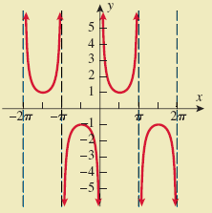
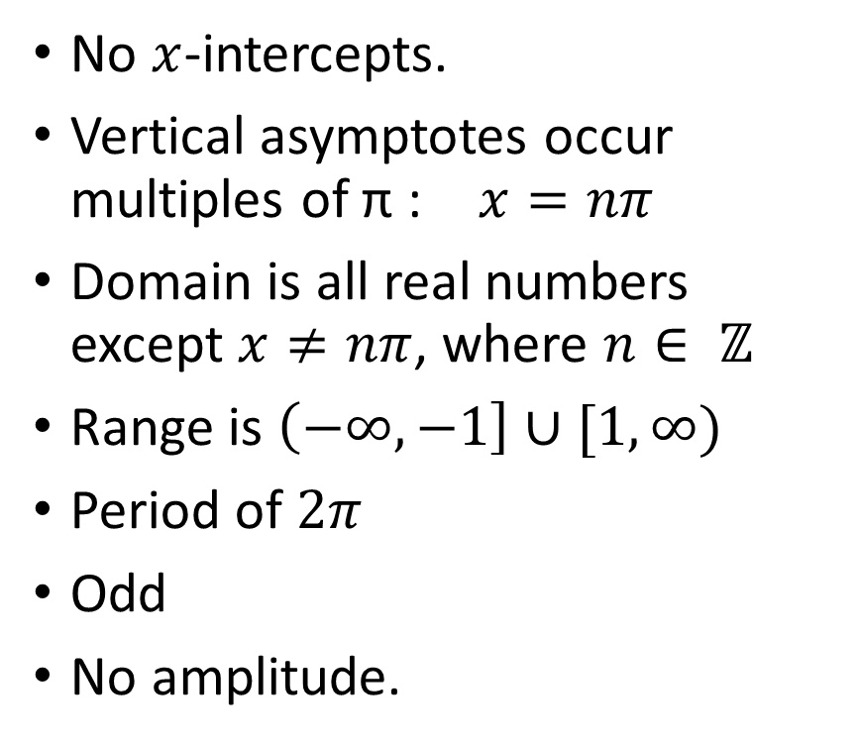

The cosecant function, $f(x) = csc⁡(x)$
No $x$-intercepts.
Vertical asymptotes occur multiples of π : $x=nπ$
Domain is all real numbers except $x≠nπ$, where $n∈ ℤ$
Range is $\left(−∞,−1\right]∪[1,∞)$
Period of $2π$
Odd
No amplitude.

Slide 12
Relationship between Sine and Cosecant

